Slide 1
Risk Game Project

Slide 2
Topic
Introduction
Design
Implementation
Evaluation
Testing

Slide 3
Project Introduction
Project aim
Game Rule
Used Tools
Programming Language

Slide 4
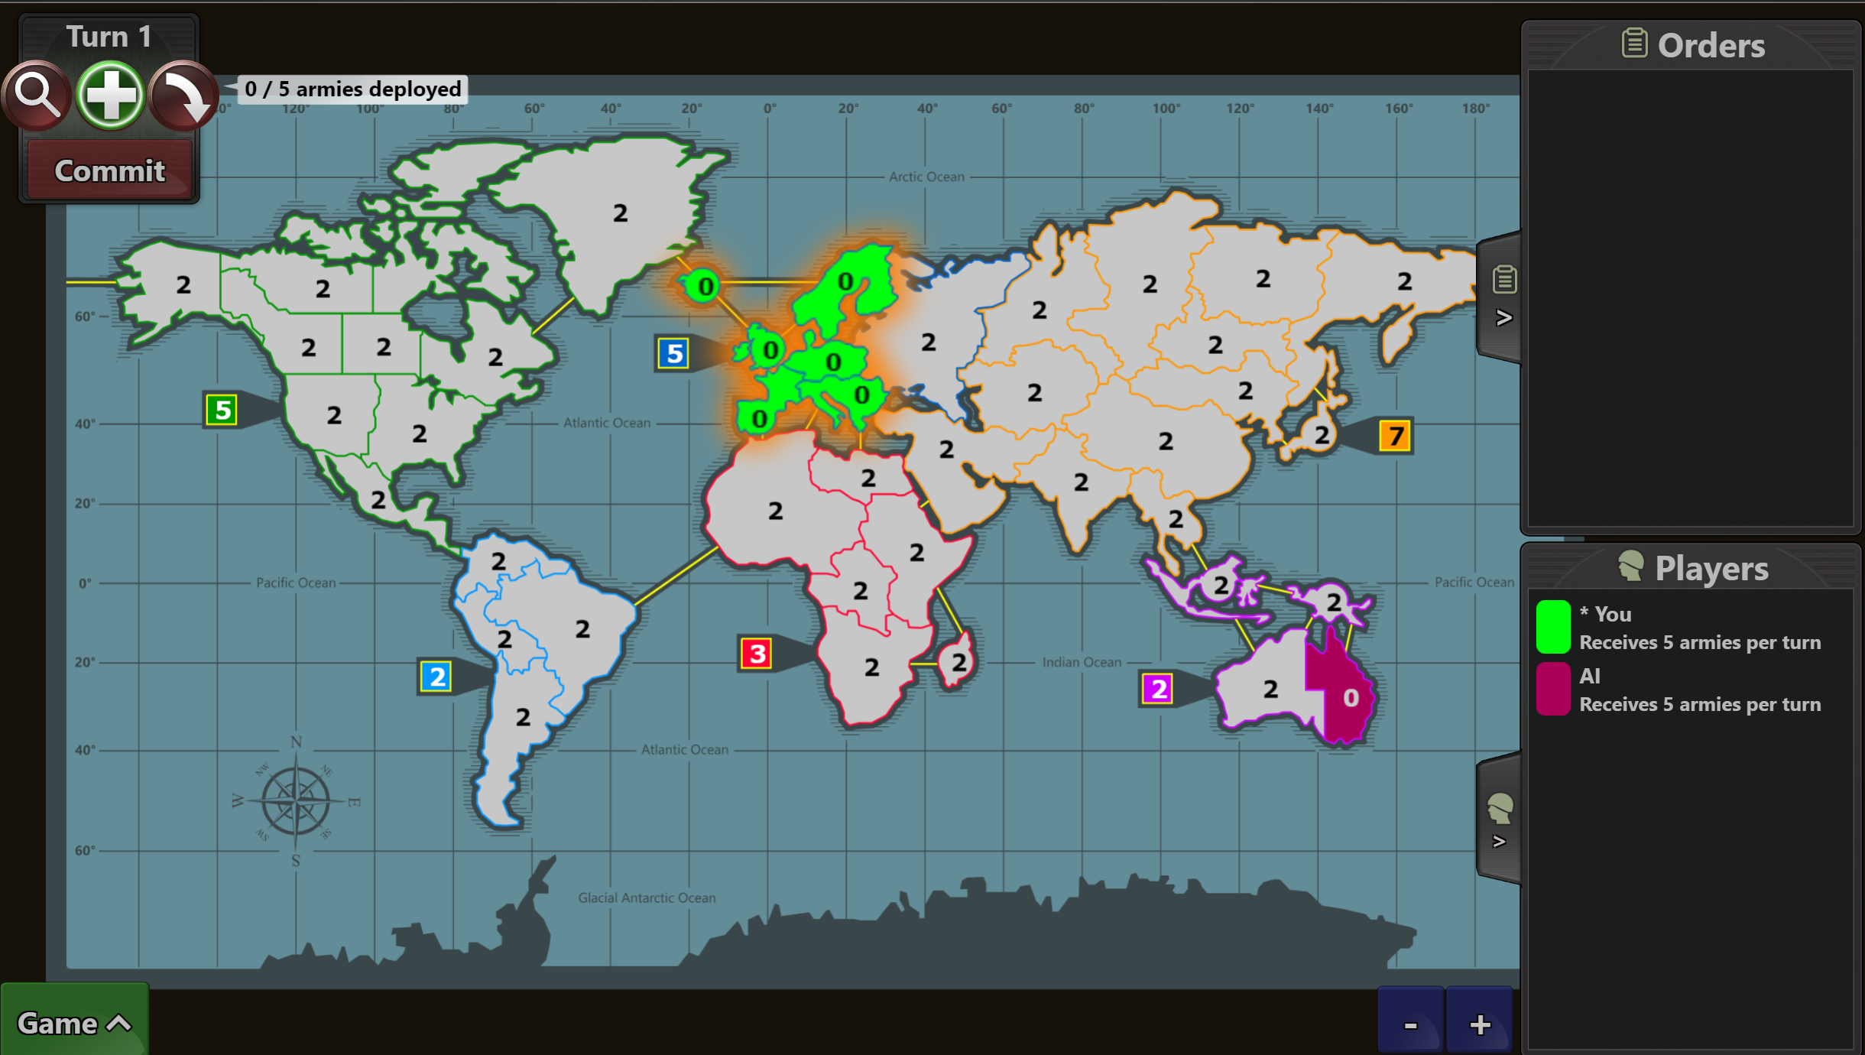
Project Introduction Project Aim
Board card game, RISK;
Turn Based strategy game;
Up to six player;
Three different levels of AI;

Slide 5
Project Introduction Game Rule
Warzone – a simple version of the RISK;
Each player selects their first country;
Run in turn:
Recruit;
Attack;
Game Over.

Slide 7



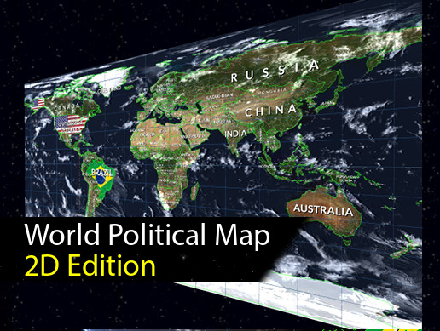
Project Introduction Programming Language and Library used
C# and Unity Engine;
WPFS and SimpleJSON.

Slide 8
Game Design
Context Model
Game View
Game Controller
Game Model

Slide 9
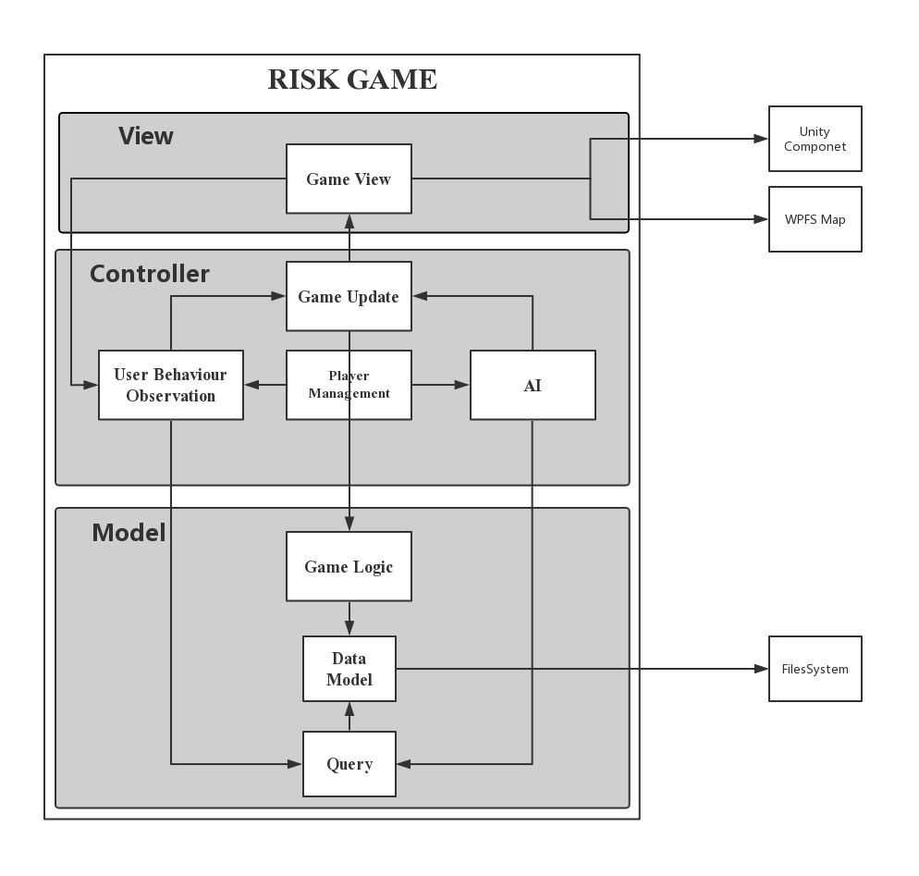
Game Design
Outer
Unity Components
WPFS Map
Local File
Inner
Encapsulation
Model View Controller

Slide 10
Implementation
Map
Logic
AI
Record

Slide 11
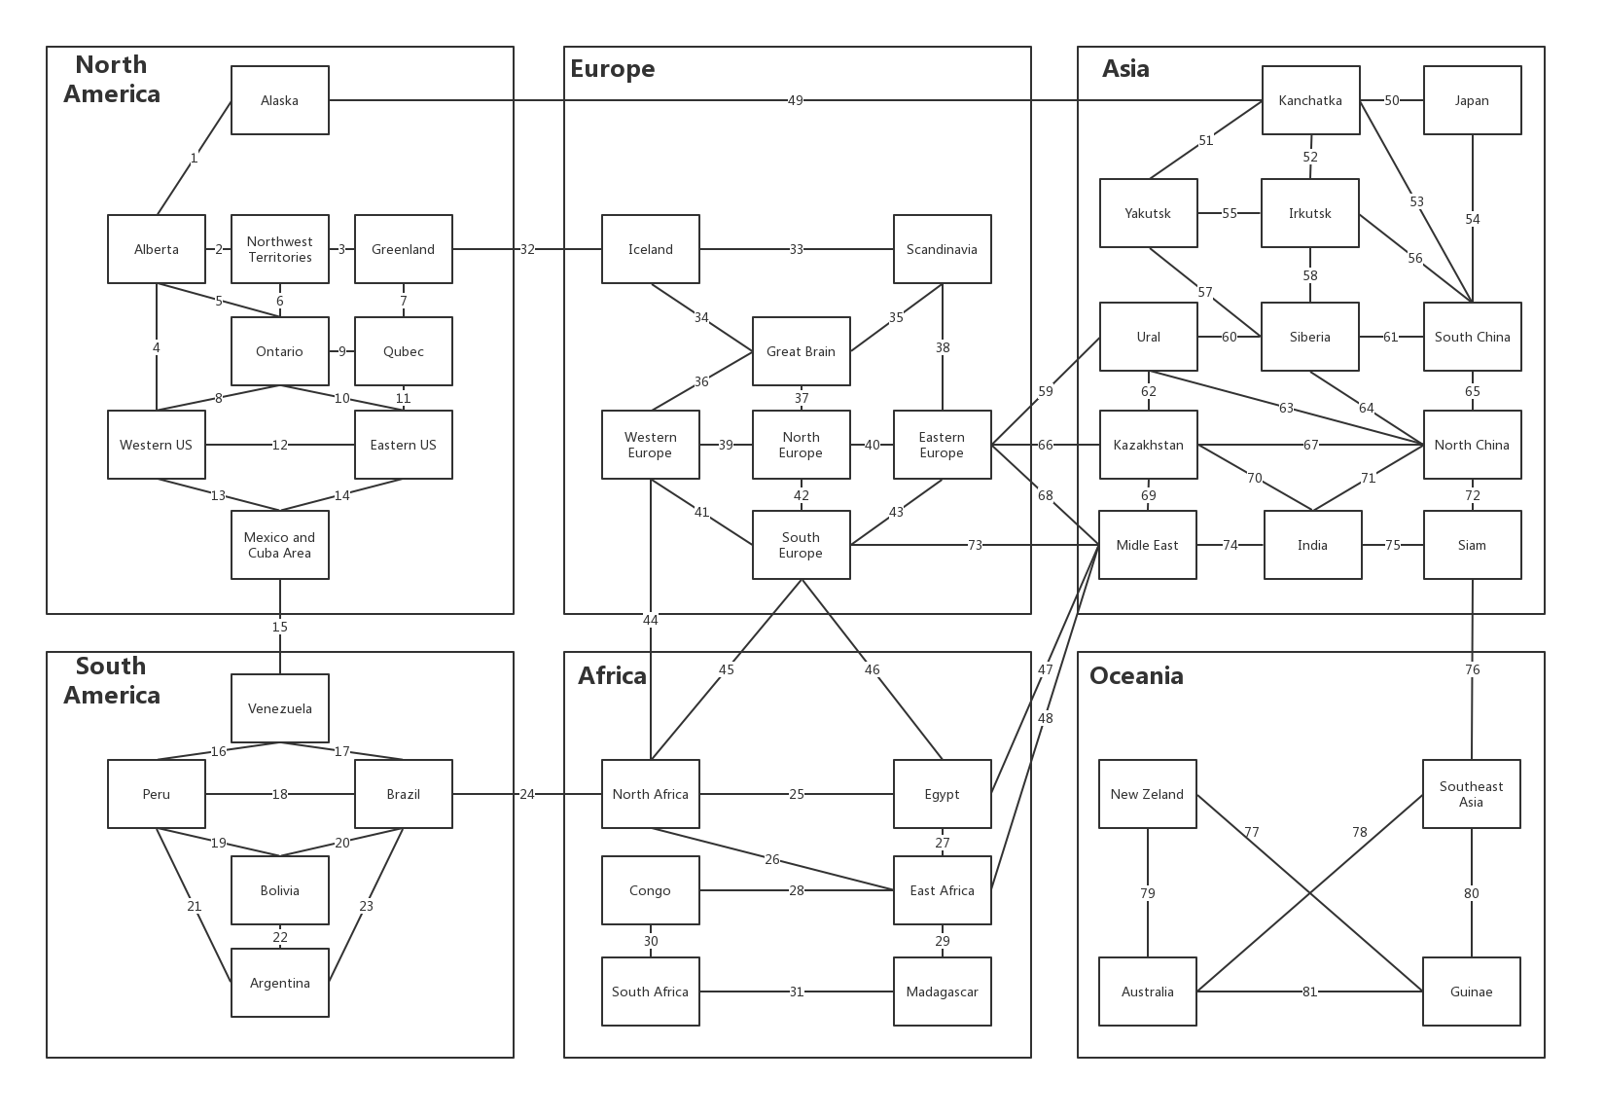
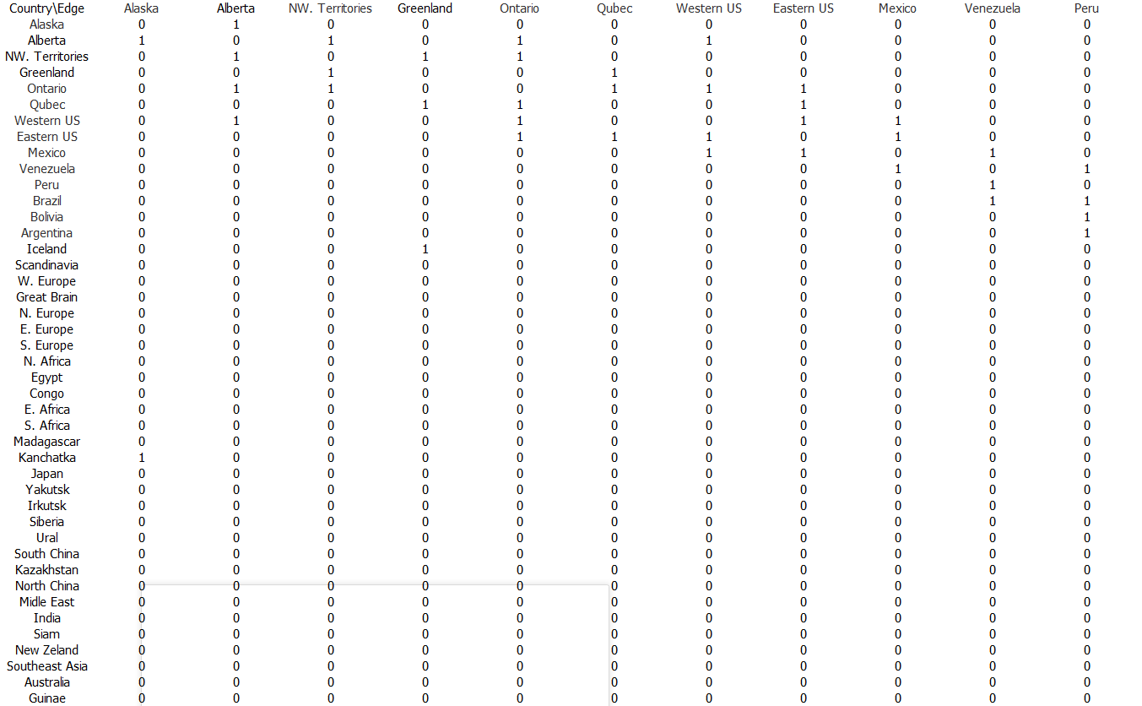
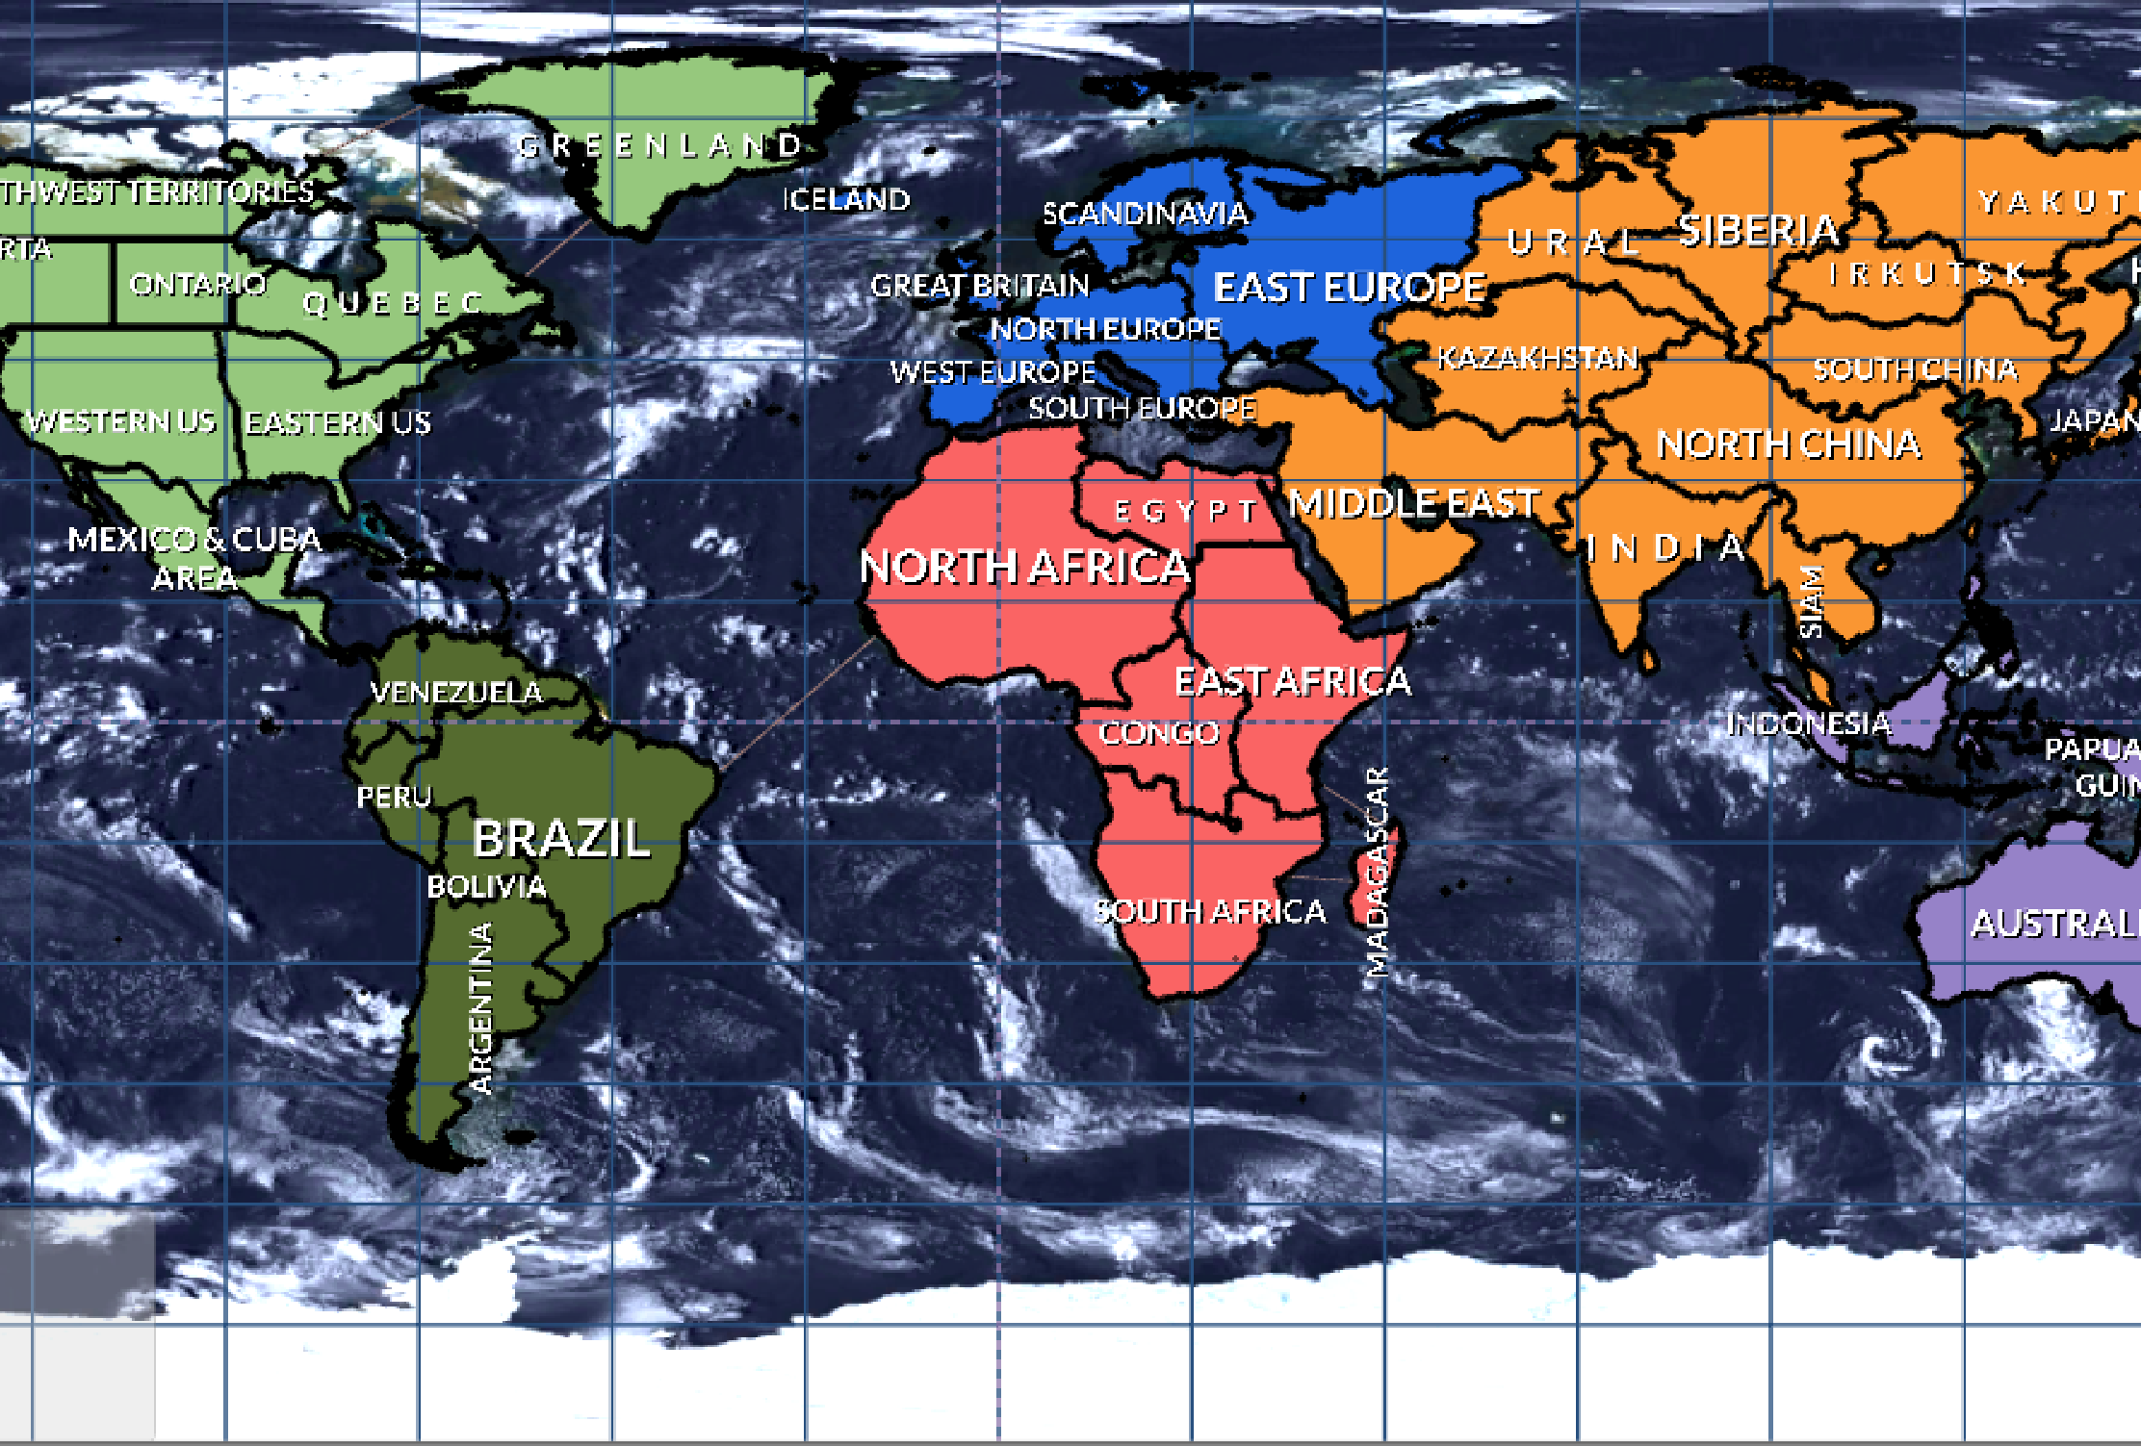
Implementation Game Map

Slide 12
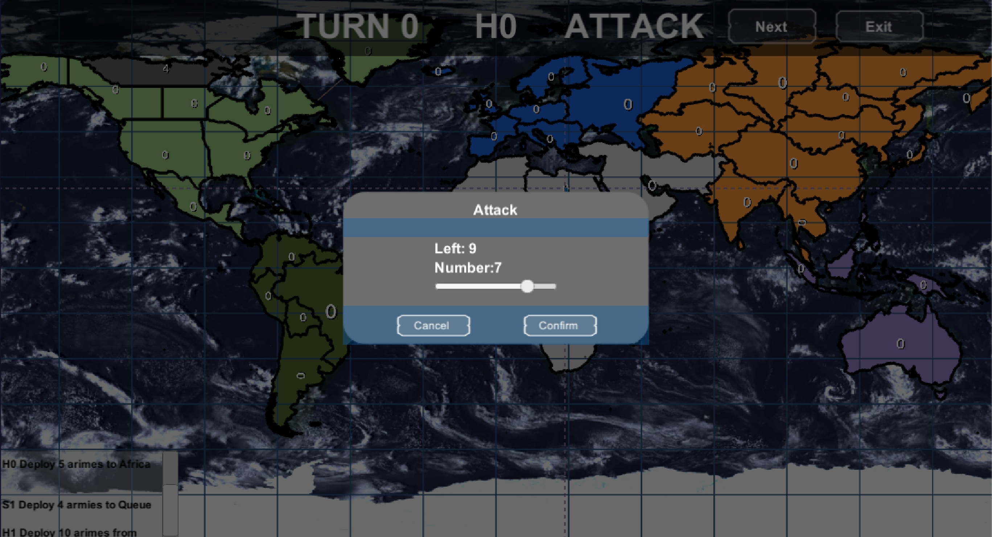
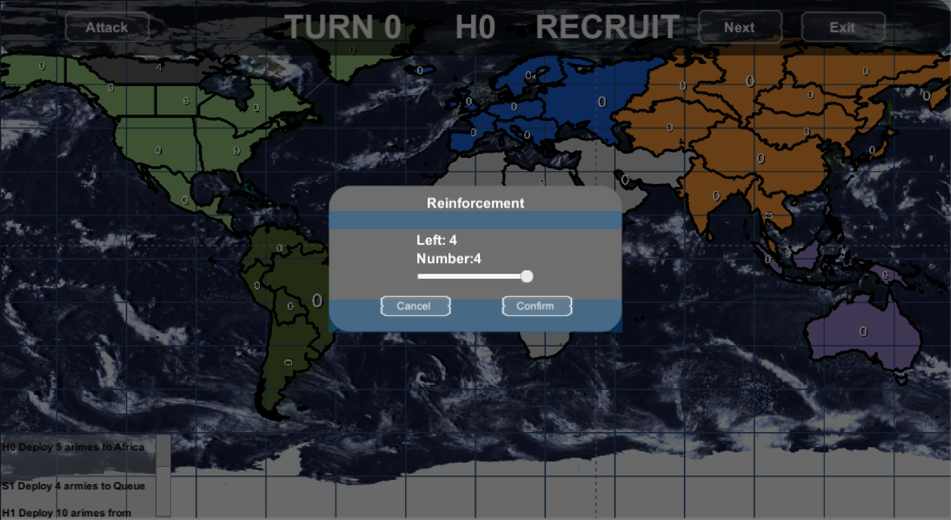
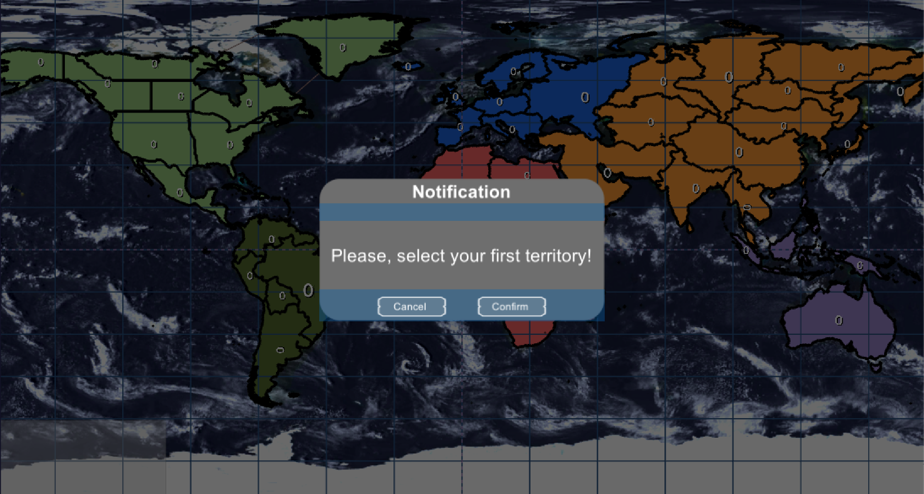
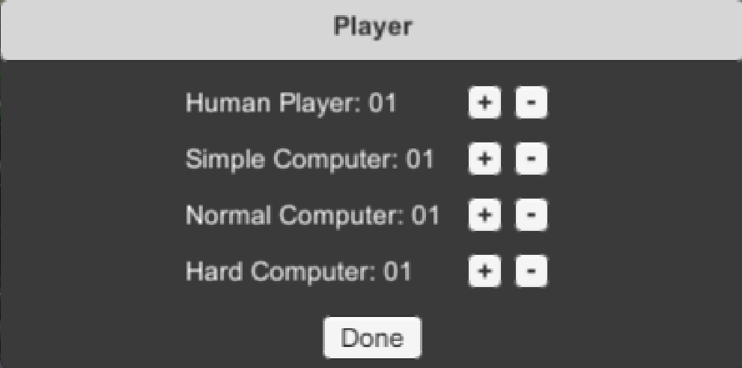
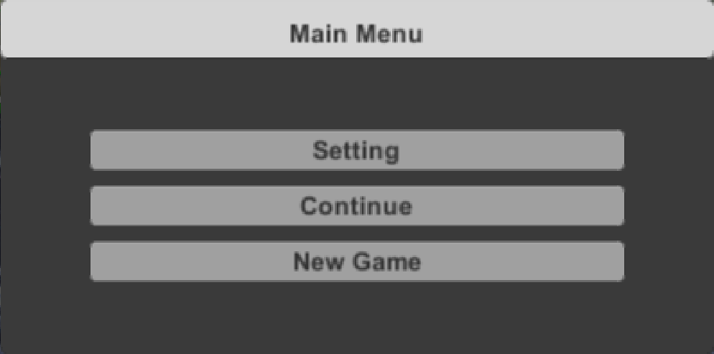
Implementation Game Logic
Initiate
Recruit
Attack

Slide 13
Implementation Artificial Intelligent
Simple AI – Random Computer Player;
Normal AI – Conservation Computer Player;
Hard AI – Aggressive Computer Player;
Observation
Reinforcement
Attack
Move

Slide 14
Estimation
Self Estimation;
Three part Estimation;
AI Estimation;

Slide 15
Test
Test Case
Initiate Test;
Recruit Test;
Attack Test;
Move Test;

Slide 16
Conclusion
Project
Turn based strategy game, The RISK.
Implementation
View: Based on unity UI components and WPFS
Logic: Recruit, Move and Attack
AI: Random, Defender and Alpha-beta
Data: Loading and Recording;
Estimation and Test

Slide 17
Reference
Assetstore.unity.com. (2019). World Map Globe Edition - Asset Store. [online] Available at: https://assetstore.unity.com/packages/tools/gui/world-map-globe-edition-41890 [Accessed 20 Mar. 2019].
Docs.microsoft.com. (2019). C# Guide. [online] Available at: https://docs.microsoft.com/en-us/dotnet/csharp/ [Accessed 20 Mar. 2019].
Simplejson.readthedocs.io. (2019). simplejson — JSON encoder and decoder — simplejson 3.16.1 documentation. [online] Available at: https://simplejson.readthedocs.io/en/latest/ [Accessed 20 Mar. 2019].
Technologies, U. (2019). Unity - Unity. [online] Unity. Available at: https://unity.com/ [Accessed 20 Mar. 2019].
Warzone. (2019). Warzone. [online] Available at: https://www.warzone.com/ [Accessed 20 Mar. 2019].

